Slide 1
story 1
File created on: 10/28/2023 3:17:54 PM

Slide 2
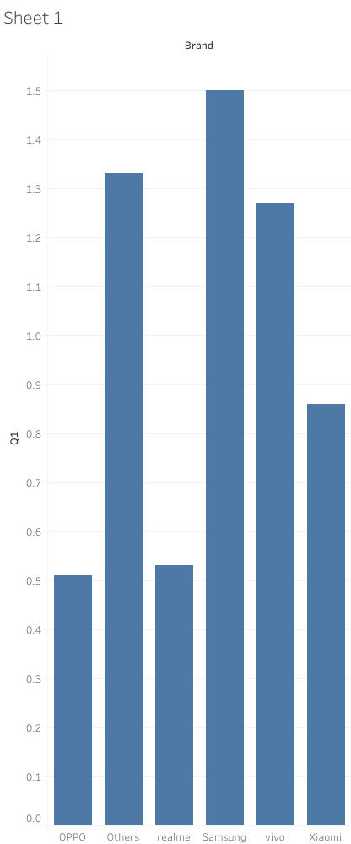

Slide 3
